Slide 1
Lec: 21 - SFSS - SP - 04a
Introduction to Poverty and related concepts

Slide 2
Poverty
Amounts
Health
Other Basic Needs of the Life

Slide 3
Poverty
Condition
Unable to Fulfill Basic Needs

Slide 4
Poverty
Situation
One can Not get the Basic Needs

Slide 5
According to UN
Deprivation of Basic Human Needs
Including Food & Safe Drinking Water
Shelter
Sanitation Facilities & Health
Education & Information

Slide 6
UN Conference on Trade and Development
Poor
A person who Live on Less than
Two Dollars a Day

Slide 7
UN Conference on Trade and Development
Anyone with Less than One Dollar a Day is Living in Extreme Poverty

Slide 8
Poverty is a state or condition in which a person or community lacks the financial resources and essentials to enjoy a minimum standard of life and well-being that's considered acceptable in society.

Slide 9
Goddard:
Poverty is insufficient supply of those things which are required for an individual to maintain himself and those dependents upon him in health and vigor.

Slide 10
Valentine:
A Condition of want which is desired & needed but can not satisfies / Fulfills is poverty.

Slide 11
Peter Townsend:
Lack the resources to obtain the Types of Diet, Participate in Activities & have the Living Condition & Amenities / Facilities.

Slide 12
Annual Poverty Rate:
Percent of people who were in poverty in a Calendar year.

Slide 13
Poverty Line / Threshold:
The Minimum Level of Income which is required to Achieve an Adequate Standard of Living.

Slide 14
National Poverty Lines
Definitions of the poverty line may vary considerably among nations. For example, rich nations generally employ more generous standards of poverty than poor nations. Thus, the numbers are not comparable among countries.

Slide 15
The International Day for the Eradication of Poverty is celebrated every year on October 17 throughout the world. It was officially recognized by the United Nations.
In December, 1992, the UN General Assembly officially declared October 17 as the date for the International Day for the Eradication of Poverty (resolution 47/196 of December 22, 1992).
(http//www.un.org/en/events/povertyday/background.shtml)

Slide 16
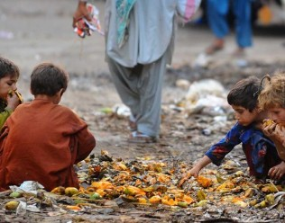

Slide 17
Thanks

